Slide 1
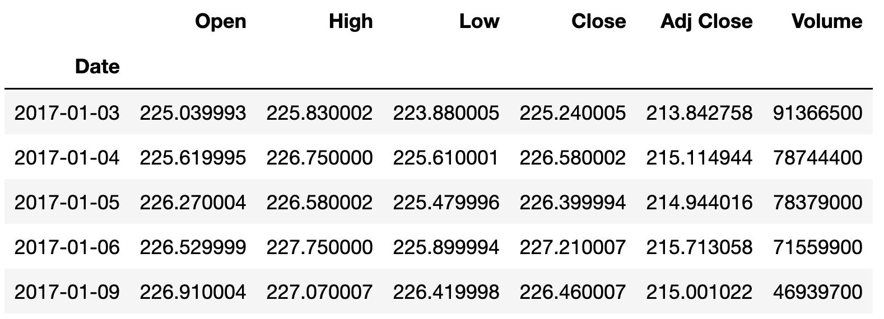

How to get Yahoo Finance Data

Slide 2
How to get Yahoo Finance Data
pandas_datareader
yfinance + pandas_datareader
yfinance

Slide 3
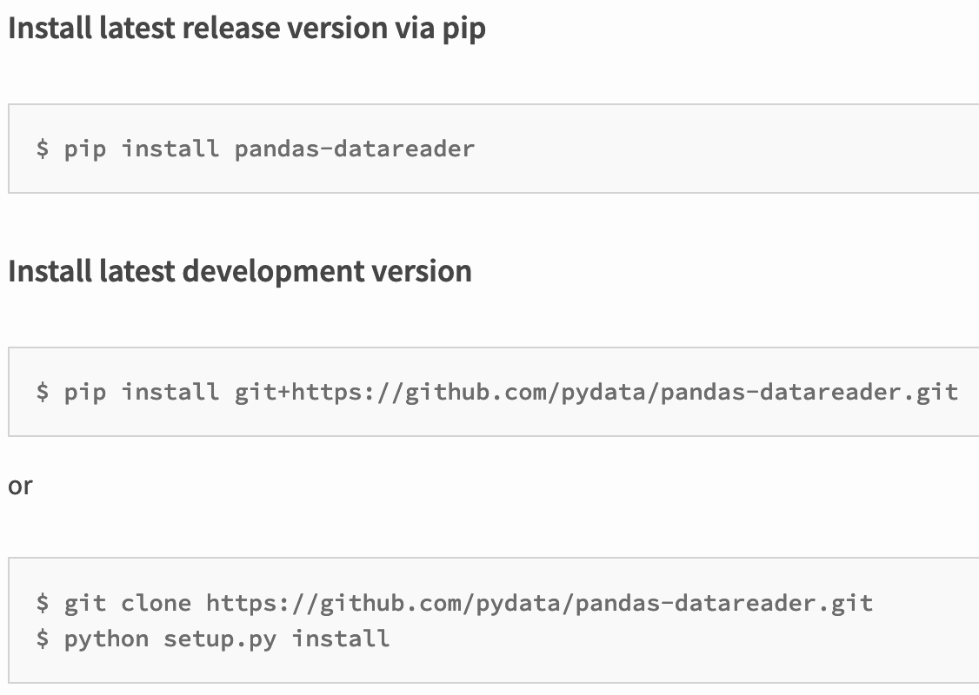
pandas_datareader

Slide 4
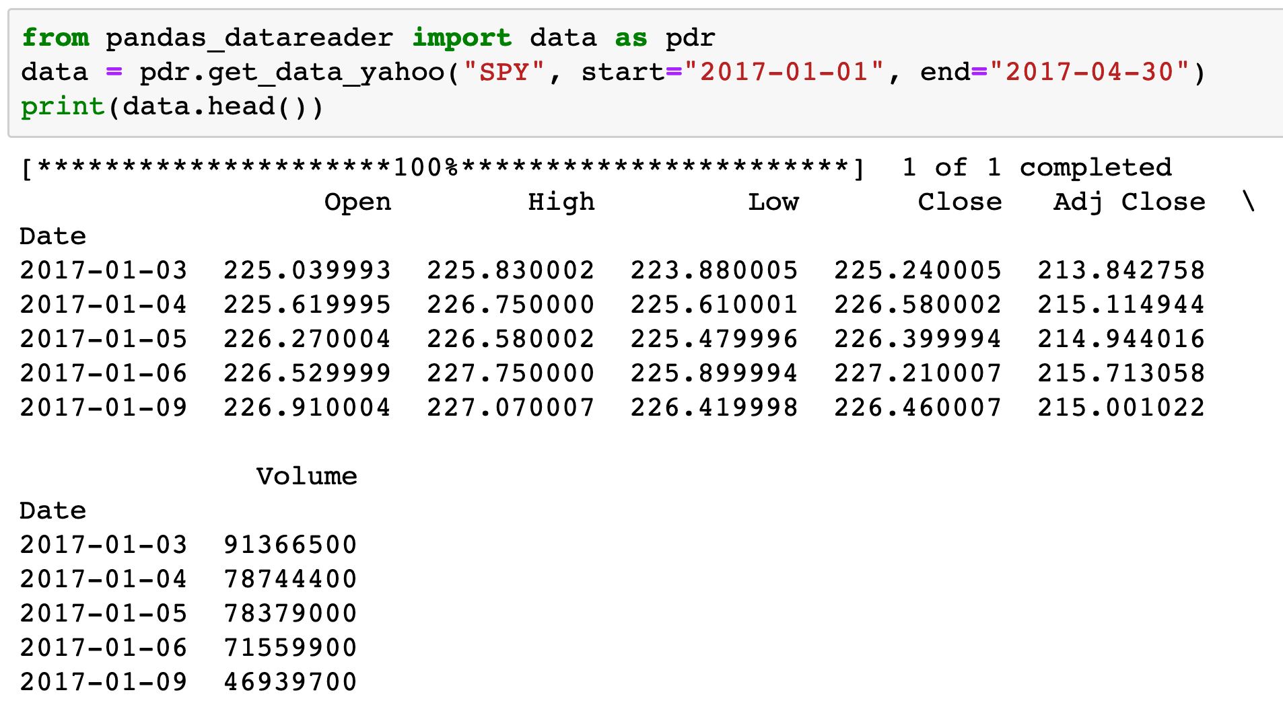
pandas_datareader

Slide 5
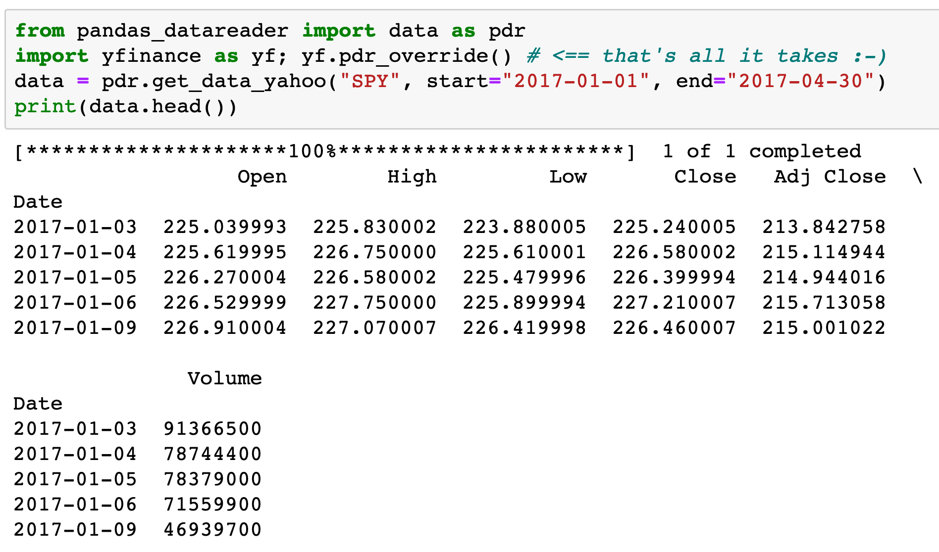
yfinance + pandas_datareader

Slide 6
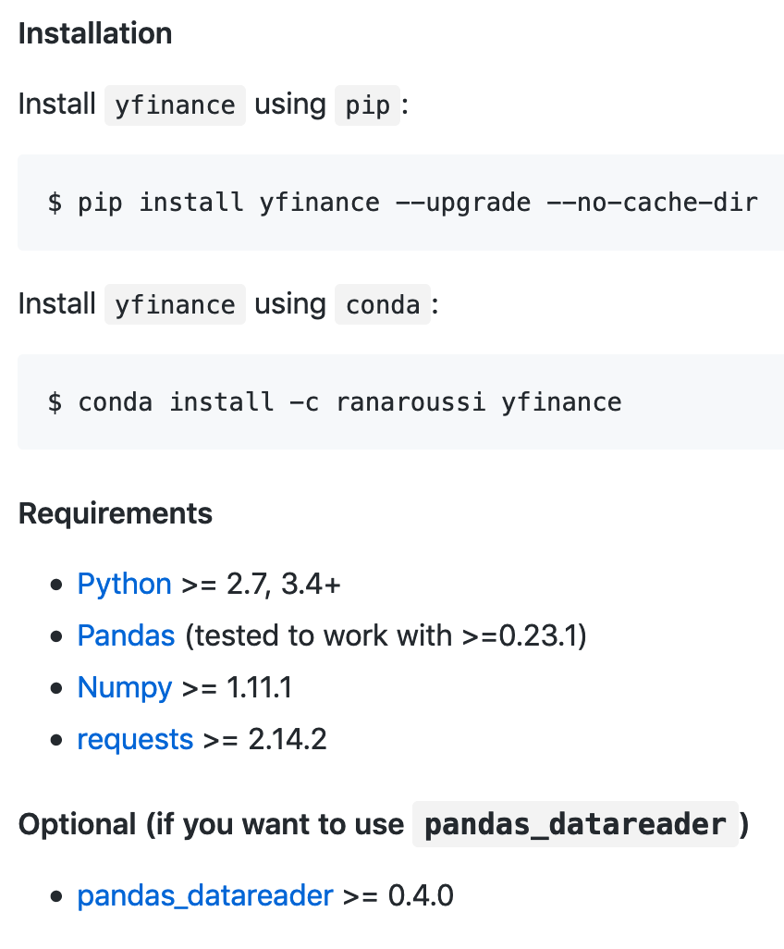
yfinance

Slide 7
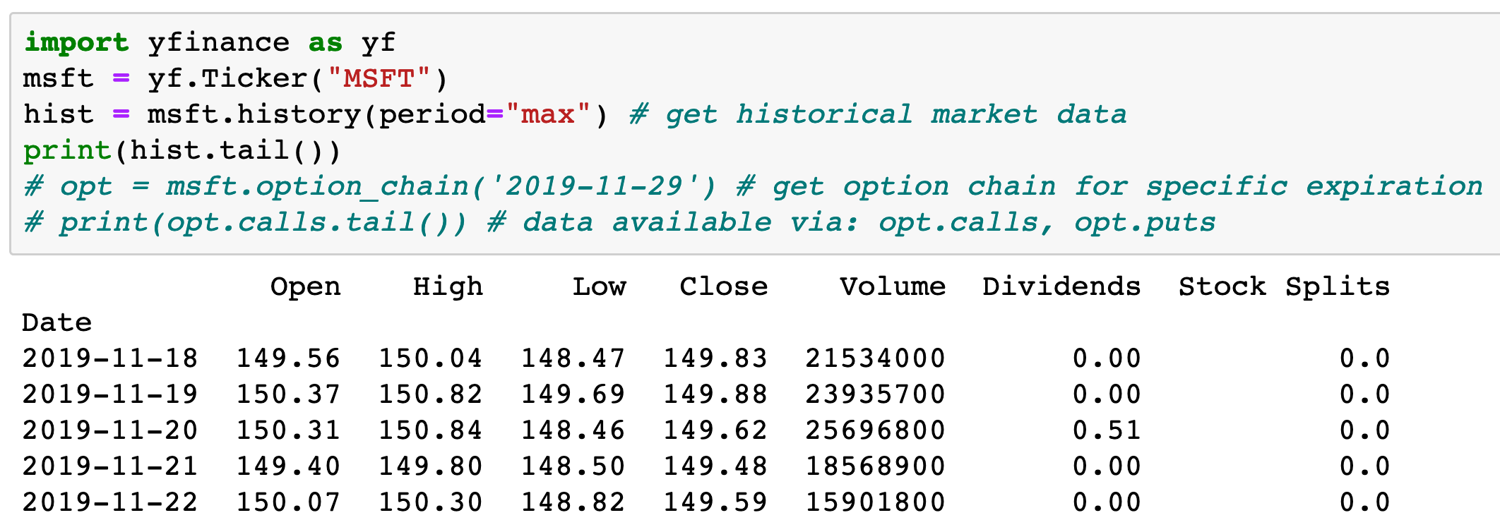
yfinance

Slide 8
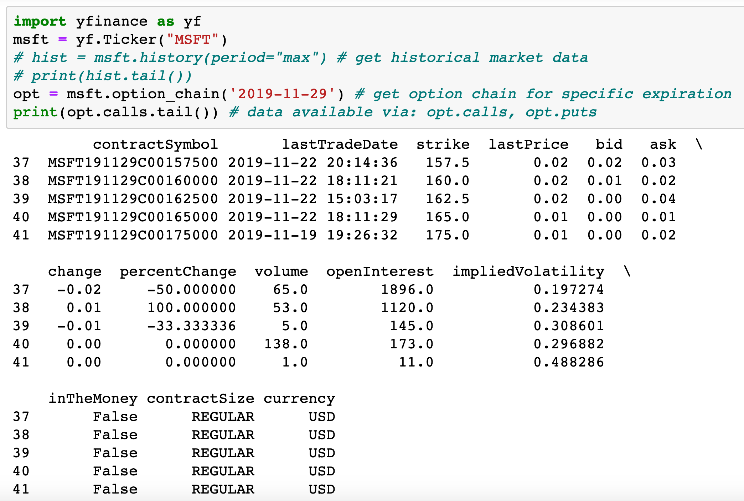
yfinance

Slide 9
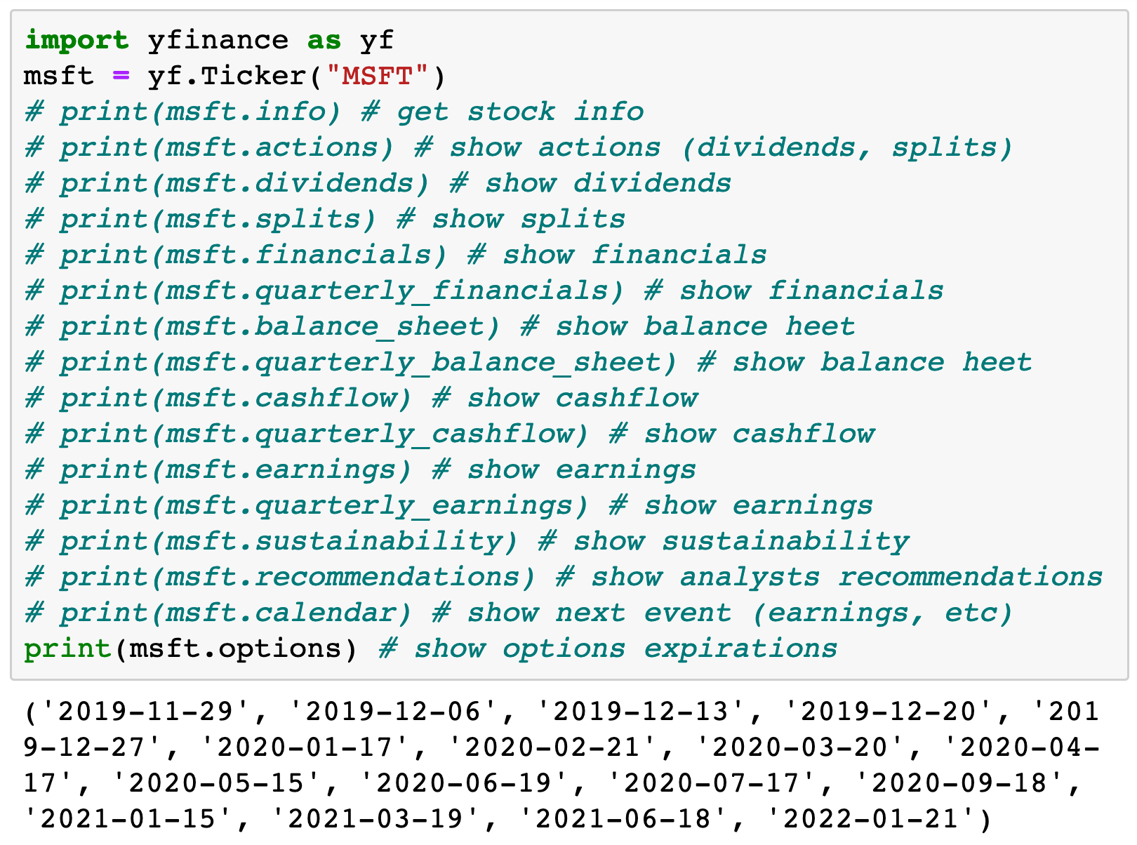
yfinance

